Slide 1


IPL DATA ANALYSIS
ANALYZING PERFORMANCE METRICS AND INSIGHTS

Slide 2


TASK OVERVIEW
Objective: Analyze IPL data to understand team and player performance, match outcomes, and key metrics.
Data Sources: Multiple tables including match summaries, player statistics, and performance records.
Tools Used: Power BI for visualization and analysis.
Scope: Covering team performance, batting insights, and bowling insights.
Outcome: Detailed insights into IPL dynamics and performance metrics.

Slide 3


Goal: To provide a comprehensive analysis of IPL cricket data.
Focus Areas: Team performance, batting statistics, and bowling metrics.
Methodology: Utilize Power BI to visualize and interpret data from various tables.
Deliverables: Insights on winning percentages, runs chased, strike rates, and more.
Impact: Help in understanding trends, strengths, and areas for improvement for teams and players.
OBJECTIVE

Slide 4
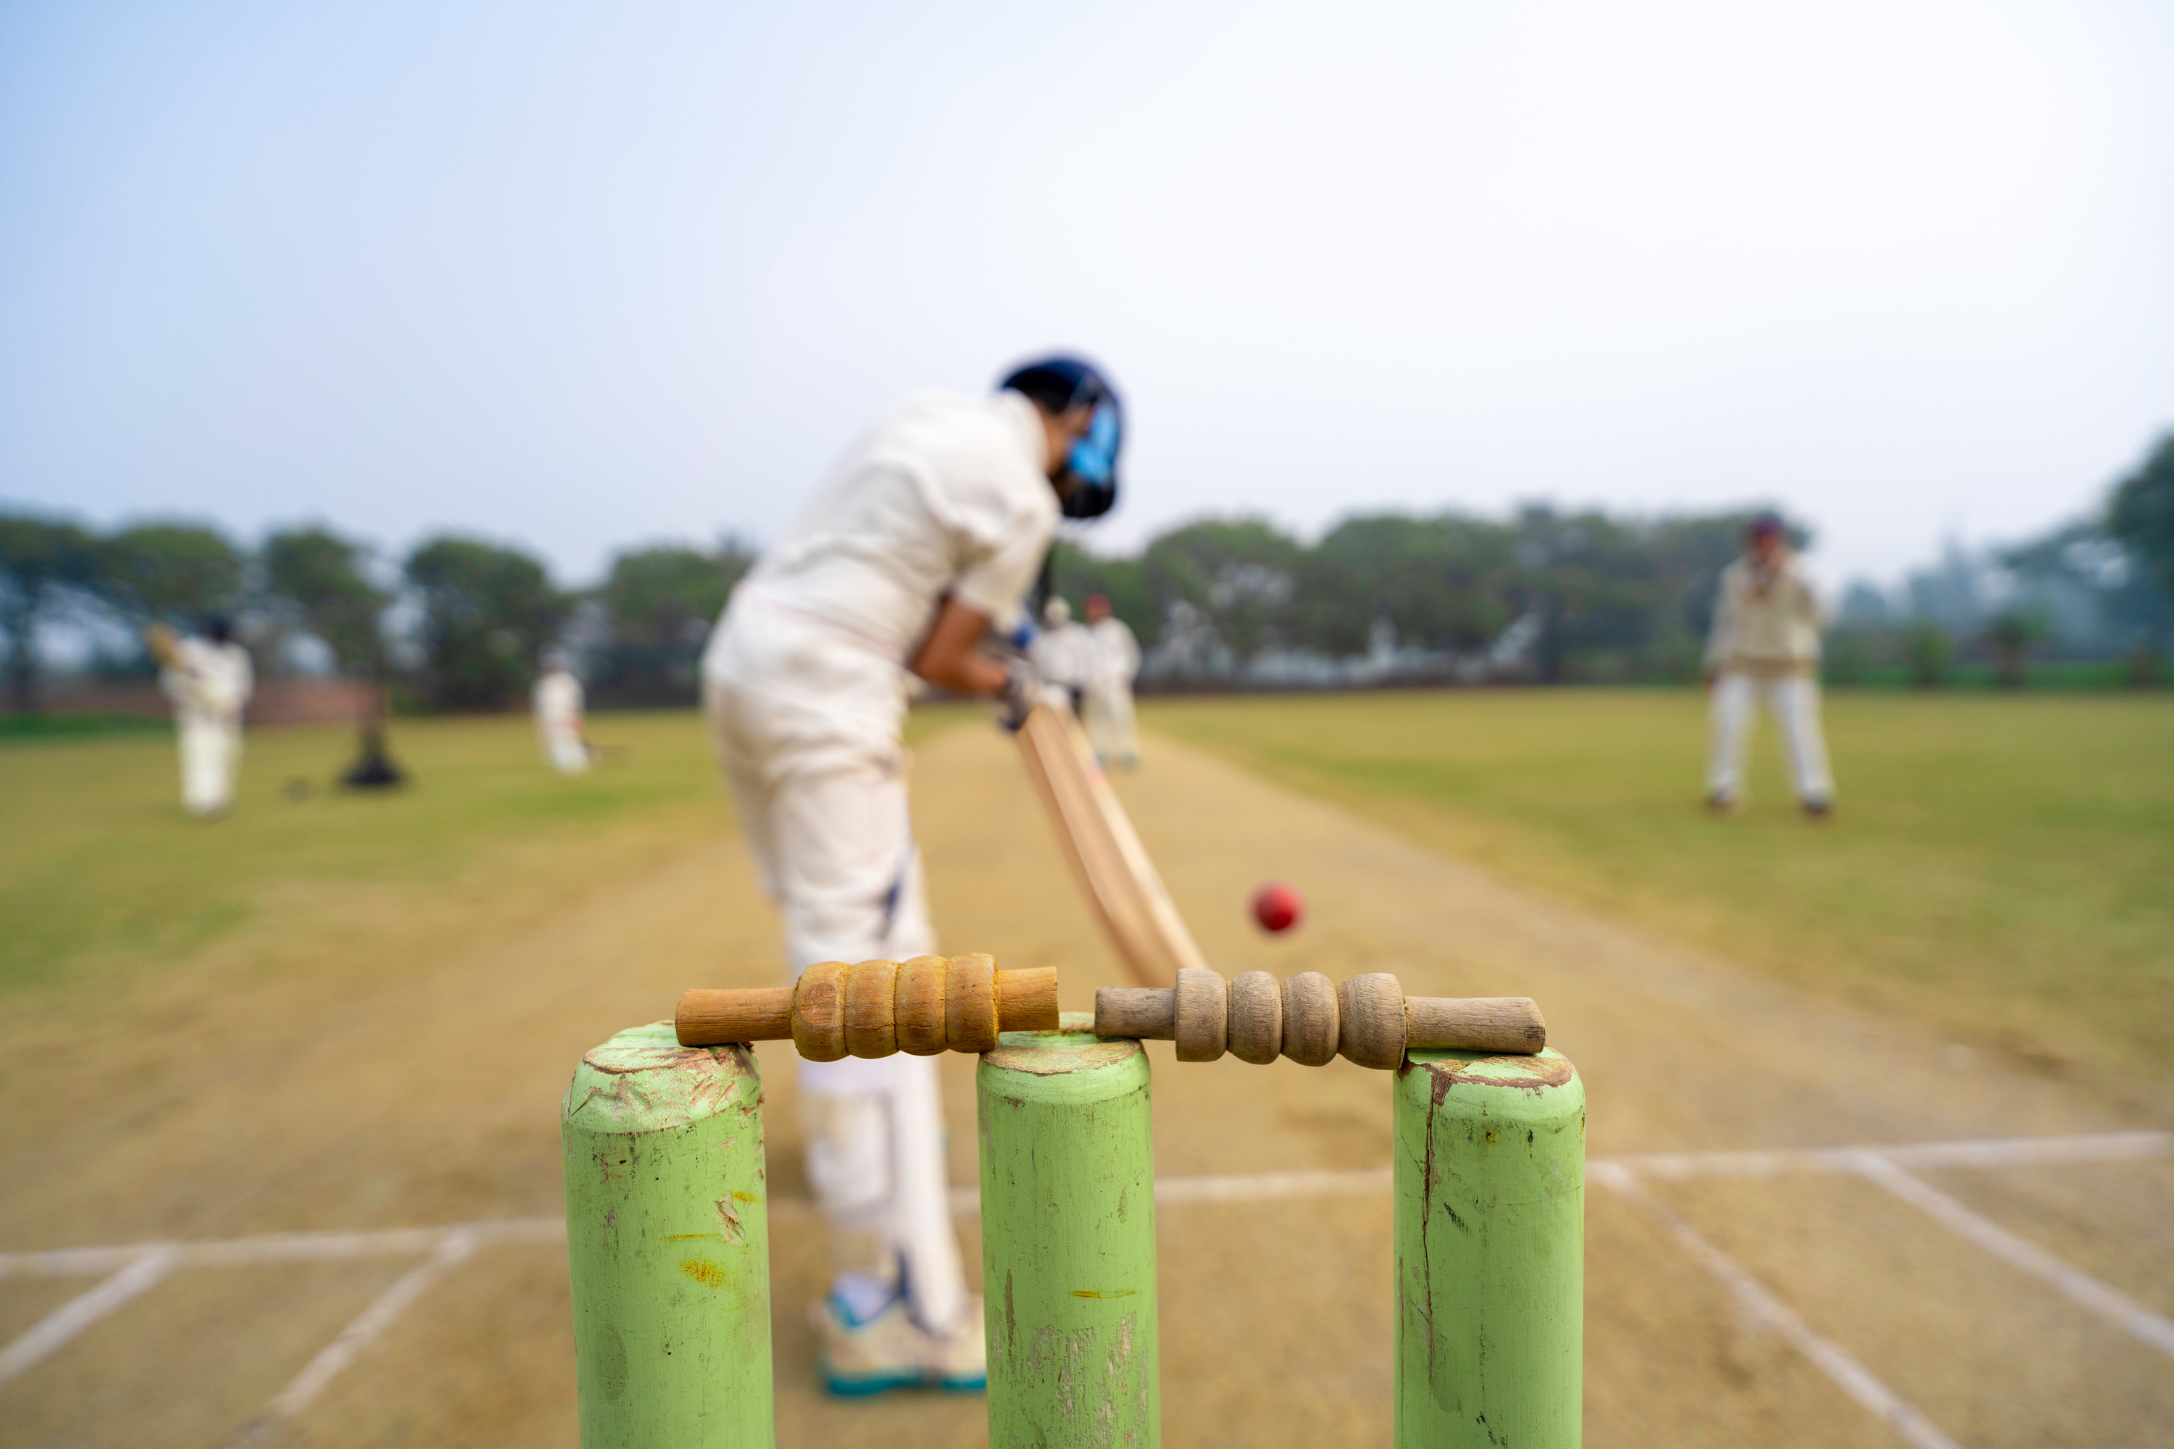
Team Performance Insight
Analysis of team winning percentages and overall performance.
Comparison of top teams based on various metrics.
Visualization of winning types and performance trends.
PROJECT STRUCTURE
Batting Insight
Examination of top batsmen based on strike rate and boundary percentage.
Detailed analysis of batting averages and scoring patterns.
Visualization of key batting metrics to identify trends.
Bowling Insight
Analysis of top bowlers based on economy rates and strike rates.
Examination of dot ball percentages and their impact.
Visualization of bowling performance metrics to highlight key bowlers.

Slide 5










MEET THE CRICKET TEAMS

Slide 6

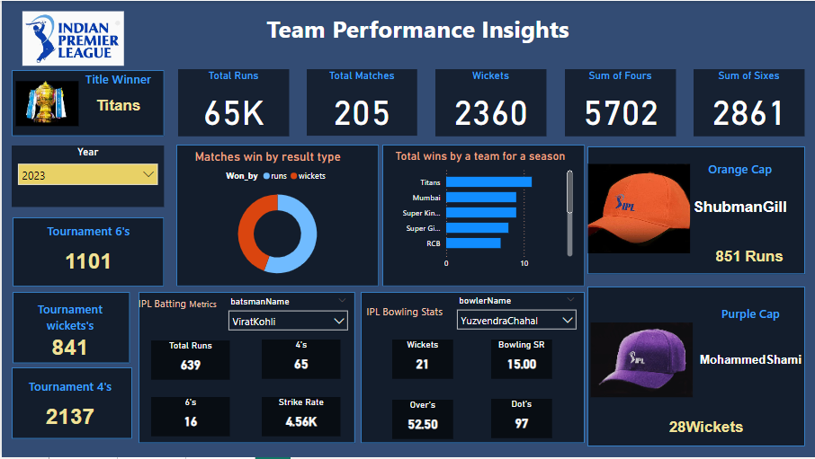
TEAM PERFORMANCE INSIGHTT

Slide 7

TEAM PERFORMANCE INSIGHTT
Cards Analyzed: Includes total runs, total matches, total wickets, sum of fours, and sum of sixes over the last 3 years, with a focus on seasonal winners.
Result Type Analysis: A doughnut chart illustrating team victories by result type (runs or wickets).
Seasonal Wins: A column bar chart depicting the top teams total wins for each season.
Awards Analysis: Highlights the Purple Cap and Orange Cap winners for each season.
Tournament Metrics: Includes tournament wickets, fours, and other key statistics across seasons.
Detailed Metrics: Two matrices for IPL batting and bowling, showing key statistics like total runs, strike rate, wickets, and dot balls by batsman and bowler names.

Slide 8
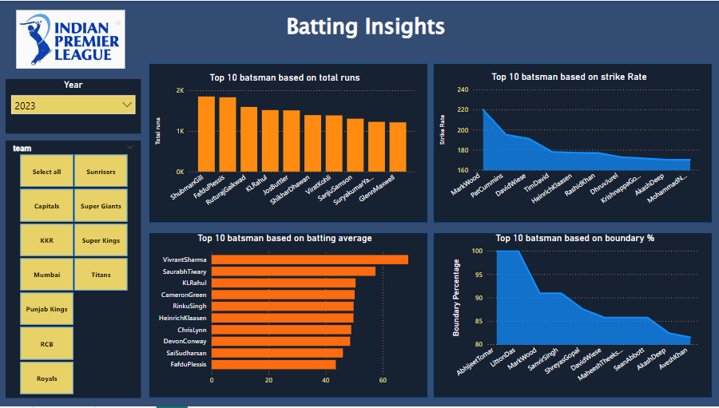
BATTING INSIGHTT

Slide 9


BATTING INSIGHTT
Top 10 Batsmen by Total Runs: Shubman Gill led the chart with the highest total runs.
Strike Rate Leaders: Top 10 batsmen by strike rate shown in an area chart.
Batting Average: Vivrant Sharma topped the list with the highest batting average.
Area chart representing the top 10 batsmen based on boundary percentage

Slide 10
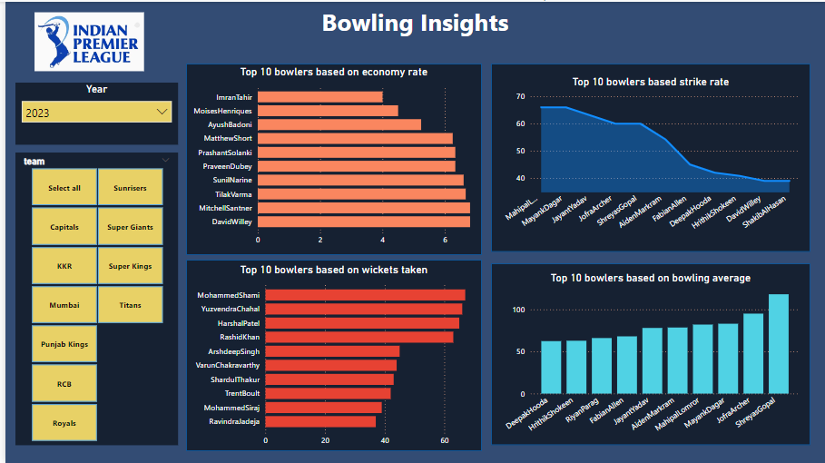
BOWLING INSIGHTT

Slide 11


BOWLING INSIGHTT
Bowling Insight
Economy Rate: An analysis of economy rate by bowler name.
Bowling Strike Rate: A chart showing bowling strike rates by bowler name.
Wickets Taken: A row bar chart depicting the sum of wickets by bowler name.
Bowling Average: A vertical bar chart showing the bowling average by bowler name.

Slide 12


CONCLUSION
In conclusion, our IPL data analysis focused on providing a comprehensive understanding of the 2023 season's dynamics. While the analysis can be adjusted to explore data from the 2022 and 2021 seasons, we concentrated on 2023 for simplicity and clarity in this presentation.
Our insights revealed Gujarat Titans as the champions, with Shubman Gill and Mohammed Shami emerging as standout performers. The analysis highlighted top teams and players across various metrics, offering valuable insights into their strengths and performance trends.
Using Power BI, we visualized key data points, uncovering patterns that can inform future strategies and decision-making. This approach not only provides an understanding of the 2023 season but also establishes a framework for analyzing other seasons and improving performance in upcoming tournaments.

Slide 13

THANK
YOU

